Slide 1
BUDS: Sprint 1
Workflow management system

Slide 2
Team Members
Sophie – SCRUM Master, help on front/ back end
Gavin and Noah M – Back End
Noah B – Front End

Slide 3
Goals for sprint One
Continue to develop the GUI login screen and develop a home page
Begin to work on an ER diagram for tickets and logins
Decide on what database server to use
Finish the Web Browser Demo and become more familiar with GitHub
Organize our Trello board so members can easily follow tasks

Slide 4
Goals Accomplished
Created a rough draft of a home page for Work-Flow
Created a rough draft of our ER Diagram
Decided to use Azure to host our SQL server
Finished Web Browser Demo and presented
Organized Trello board to have different boards for each Sprint

Slide 5

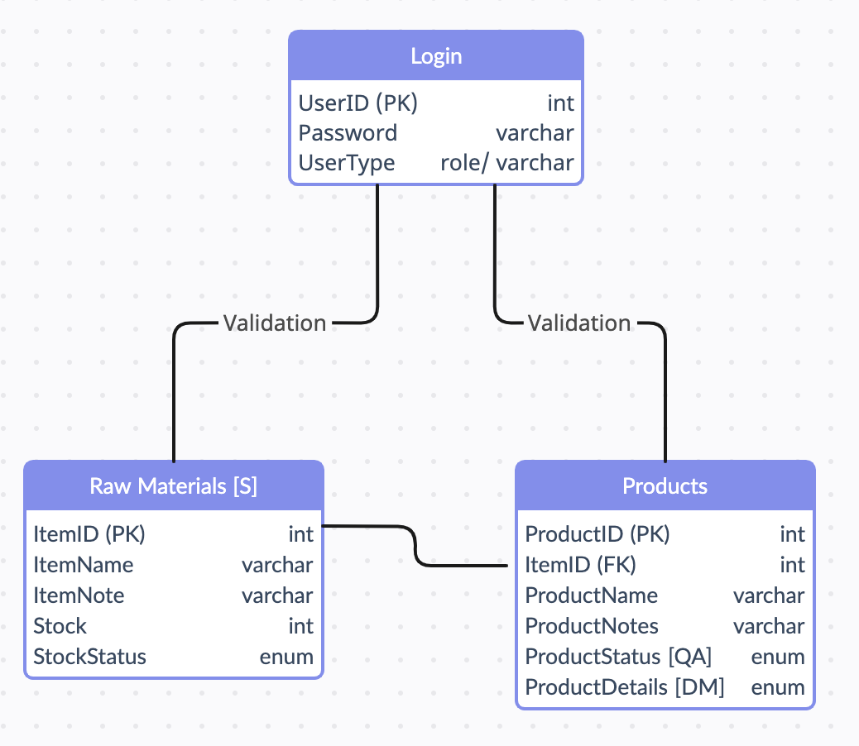
ER Diagram
Utilizing "Roles" to set permissions for user type
Potential Setup:
Role | Permissions
Admin | N/A
Stockiest | Read RM + update select columns
Product Manager | Read RM + P, update StockStatus, etc.
Quality Analyzer | Read P, update ProductStatus
Delivery Manager | Read P, update ProductDetails
Report Manager | Read P+RM

Slide 6
Challenges
Merging and pushing changes to GitHub
Collaborative Software Setup
Lost a day of class from doing Web Browser demos
Learning C#
Creating and connecting to Azure servers

Slide 7
Next Steps
Connect Azure database to Visual Studio
Pushing and pulling database information and creating database based on our ER Diagram
Connect database to project in C#
Refine GUI software for login and home screen
Creating and organizing a Trello board for Sprint 2

Slide 8
Questions?

